Slide 1
LONG TERM INTERNSHIP
TEAM LEADER : NARAM.ANITHA
REG NO : 720141805281
TEAM MEMBERS : ARNAPALLI. JYOTHI (720141805228)
DONDAPALLI. PRAVALLICA (720141805241)
GORLI. ATCHUTA RAO (720141805247)
VAMMI. SIRISHA (720141805308)
RAJAH RSRK RANGARAO COLLEGE , BOBBILI
INTERNSHIP : DIGITAL MARKETING (VIRTUAL INTERNSHIP)
PROJECT NAME : TECH MAHINDRA
ANDHRA UNIVERSITY
MAY 2023-JULY 2023

Slide 2

COMPREHENSIVE DIGITAL MARKETING FOR TECH MAHINDRA
.

Slide 3
Brand study,competitor analysis and buyer’s/audience’s persona
IDENTIFY COMPETITORS : Start by listing down Tech Mahindra's main competitors in the digital marketing space. These could be other digital marketing agencies, consulting firms, or technology companies offering similar services.
COMPETITOR 1:
Cognizant and Tech Mahindra are both global IT services and consulting companies, and they indeed compete in various areas, including digital marketing services

Slide 4
Competitor 2 :
Wipro and Tech Mahindra are two major IT services and consulting companies based in India, and they are indeed competitors in various areas, including digital marketing services
COMPETITOR 3:
Both companies offer digital marketing services as part of their comprehensive suite of IT and consulting services. Their digital marketing offerings may include social media marketing, SEO, content marketing, email marketing, paid advertising, data analytics, and more

Slide 5
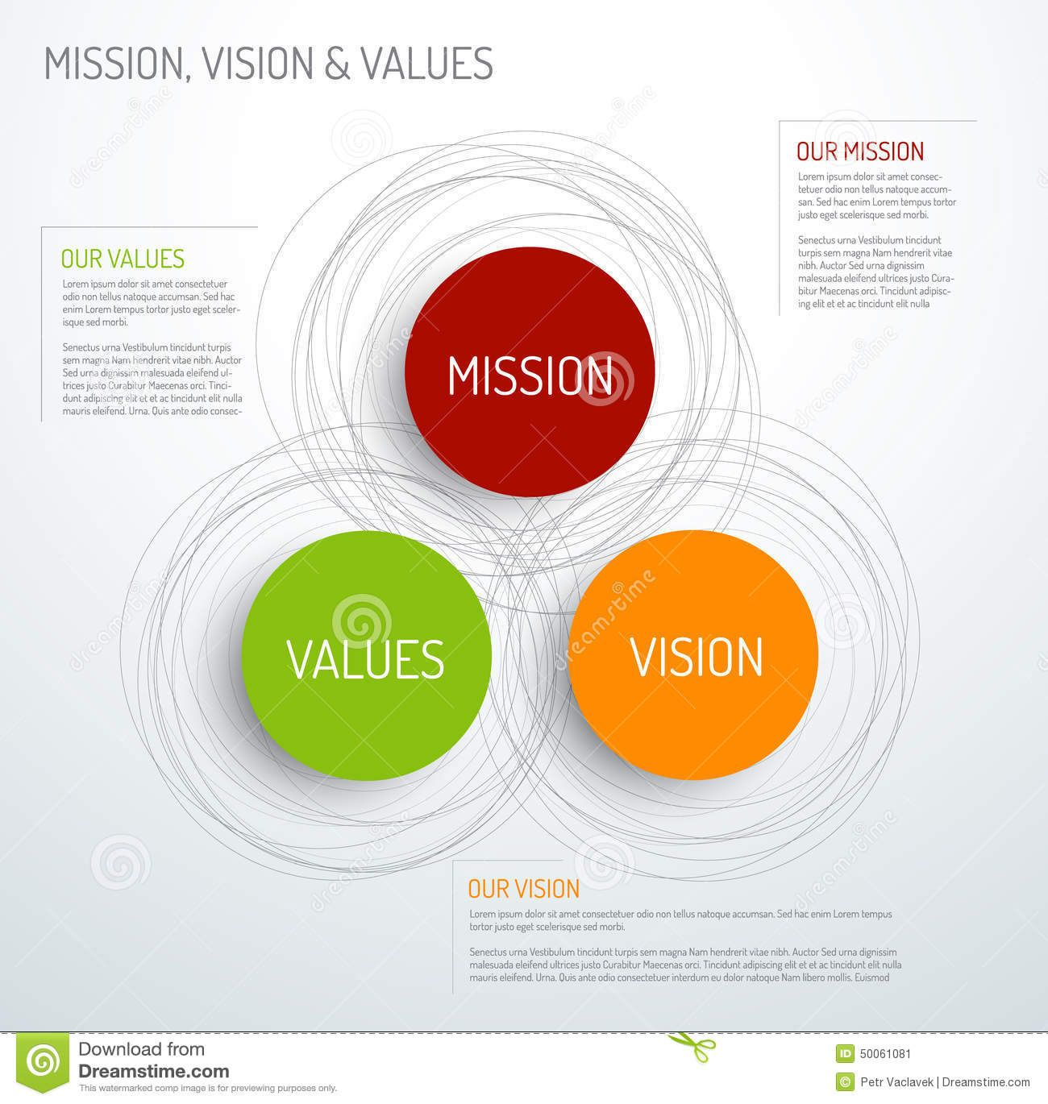
Research brand identity
MISSION/VALUES :
SIZE AND MARKET PRESENCE :both wipro and tech Mahindra are large and well established companies with a global presence.
SERVICE OFFERINGS :both companies offer digital marketing services as part of their broader IT and consulting offerings service.

Slide 6
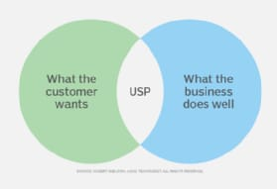
.
USP : the unique selling preposition (USP) is a critical element of any brand identity ,including a research brand identity for tech Mahindra it represents the unique value that sets tech mahindras research services apart from its competitors.
The USP should highlights what makes tech mahindras research capabilities exceptional and why clients should choose them over other research providers.

Slide 7
.
ANALYSE BRAND MESSAGING : Brand messaging is crucial in establishing a clear and consistent identity for any organization.
TAGLINE :
“TECH MAHINDRA RESEARCH :Illuminating insights , inspiring solutions.”
ANALYSIS :The tagline emphasizes tech Mahindra’s focus on providing illuminating insights through its research services.
VALUE :Value proportion
“Empowering businesses with data/driven research excellence.

Slide 8
SEO & KEYBOARD RESEARCH
SEO AUDIT : It provides proper website navigation, URL structure and internal linking.
The website is mobile-friendly and has fast loading times.
The website is accessible to search engines.
KEYBOARD RESEARCH :Keyboard research tools like google keyboard planner to find relevant keyboard with a good search volume and low competition.
ON PAGE OPTIMIZATION : review page titles, meta descriptions and header tags to ensure they are optimized for the target keyboards and provide accurate and compiling information.

Slide 9
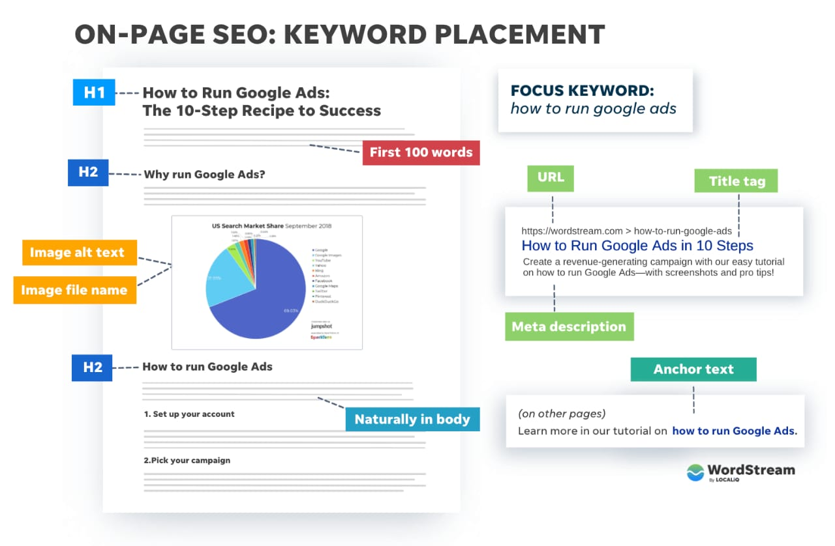
SEO & KEYBOARD RESEARCH
SEO AUDIT : SEO audit is an evaluation of a website’s search engine optimization performance and its overall online visibility.
It aims to identify areas of improvement and opportunities to optimize the website for better search engine rankings and user experience .
WEBSITE STRUCTURE AND TECHNICAL ANALYSIS :
Review the websites URL structure, sitemap and robots .
Analyse website loading speed and mobile-friendliness.
KEYBOARD RESEARCH AND ANALYSIS :
Identify relevant keyboards for the websites target audience.
Analyse keyboard competition and potential opportunities.

Slide 10
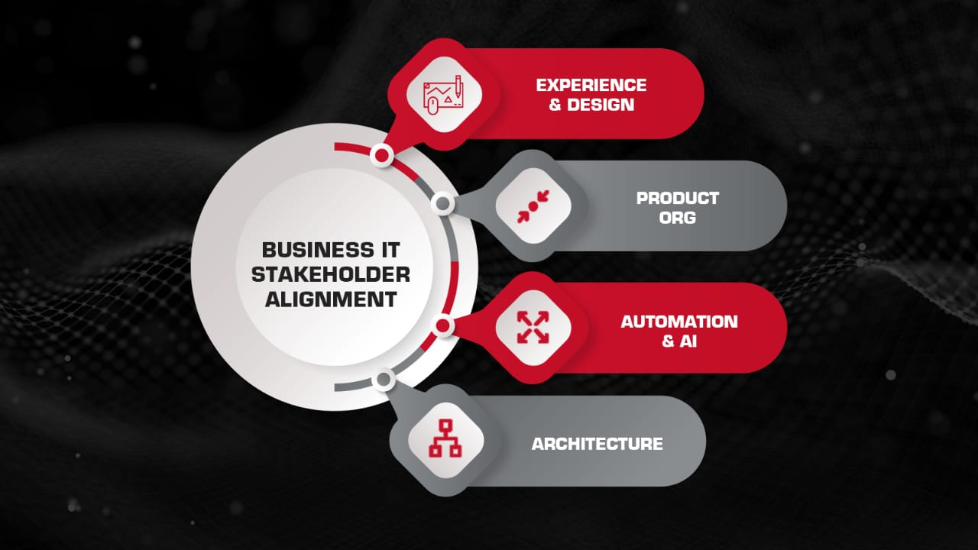
CONTENT IDEAS AND MARKETING STRATEGIES
CONTENT IDEAS : As an AI language model, I can suggest some content ideas for Tech Mahindra, a prominent IT services and consulting company.
1. CASE STUDIES AND SUCCESS STORIES : Create in-depth case studies highlighting successful projects and solutions delivered by Tech Mahindra. Showcase how the company's services have helped clients overcome challenges and achieve their business objectives.
2.THOUGHT LEADERSHIP ARTICLES : Publish articles authored by Tech Mahindra's experts on trending topics in the tech industry. These can cover subjects like AI, cybersecurity, cloud computing, digital transformation, and emerging technologies.

Slide 11
.
MARKETING STRATEGIES : marketing strategies for tech Mahindra should focus on showcasing the companie’s expertise in IT services, digital transformation, and emerging technologies while building brand awareness and attracting new clients.
DIGITAL CONTENT MARKETING : Create a comprehensive content marketing strategy that includes blocks,articles,white papers and videos.
THOUGHT LEADERSHIP AND WEBINARS : Position tech Mahindra as a thought leader in the industry by posting webinars,tech talks, and industry-specific events.

Slide 12
Content creation and curation
POST CREATION : Content creation are essential components of any successful marketing strategy for target au companies like tech Mahindra,helping them engage their target audience and build a brand authority.
UNDERSTANDING THE TARGET AUDIENCE : Before creating any content,its crucial to have a deep understanding of the target audience.
CONTENT STRATEGY AND PLANNING : Tech Mahindra should have a well-defined content strategy that assigns with its overall business objectives.

Slide 13
.
DESIGN/VIDEO EDITING : Tech Mahindra is primarily an information technology and services company with a focus on areas such as telecommunications, health care, finance, manufacturing and more.
BRAND AND MARKETING: Tech mahindras design team could play a crucial role in establishing and maintaining the company’s branding and visual identity.
VIDEO PRODUCTION AND EDITING : Tech Mahindra could have a video production team responsible for creating promotional videos, corporate videos, training materials and other video content.

Slide 14
.
SOCIAL MEDIA AD CAMPAIGNS : Social media ad campaigns can be an effective way for Tech Mahindra to reach a broader audience, engage potential clients, and promote their services. Here are some steps and strategies to consider for running successful social media ad campaigns:
1. Define Campaign Objectives: Clearly outline the goals of the ad campaign. Whether it's increasing brand awareness, driving website traffic, generating leads, or promoting specific services, defining objectives will help tailor the campaign for optimal results.
2. Identify Target Audience: Understand the ideal customer profile for Tech Mahindra's services and solutions. Use social media analytics and data to identify demographics, interests, and behaviors of the target audience.
3. Choose the Right Platforms: Tech Mahindra should focus on the social media platforms where its target audience is most active. LinkedIn is excellent for B2B marketing and professional services, while Facebook and Twitter can target a broader audience.

Slide 15
EMAIL AD CAMPAIGNS :
Email ad campaigns are an essential part of tech Mahindra’s digital marketing strategy, allowing them to reach their target audience directly, nature leads, promote their services, and drive conversions.
SEGMENTATION AND TARGETTING : Tech Mahindra would segment their email lists based on various criteria such as demographics, industry, past interactions, and interests.
EMAIL CONTENT CREATION : The marketing team at tech Mahindra would craft compelling and visually appealing email content.

Slide 16


.

Slide 17
